Slide 1
Digging deep:
Using AI & chicago police data for investigative journalism
ng In Chicago
trina reynolds-tyler, Invisible Institute
Sarah Conway, City Bureau
chicagomissingpersons.com

Slide 2
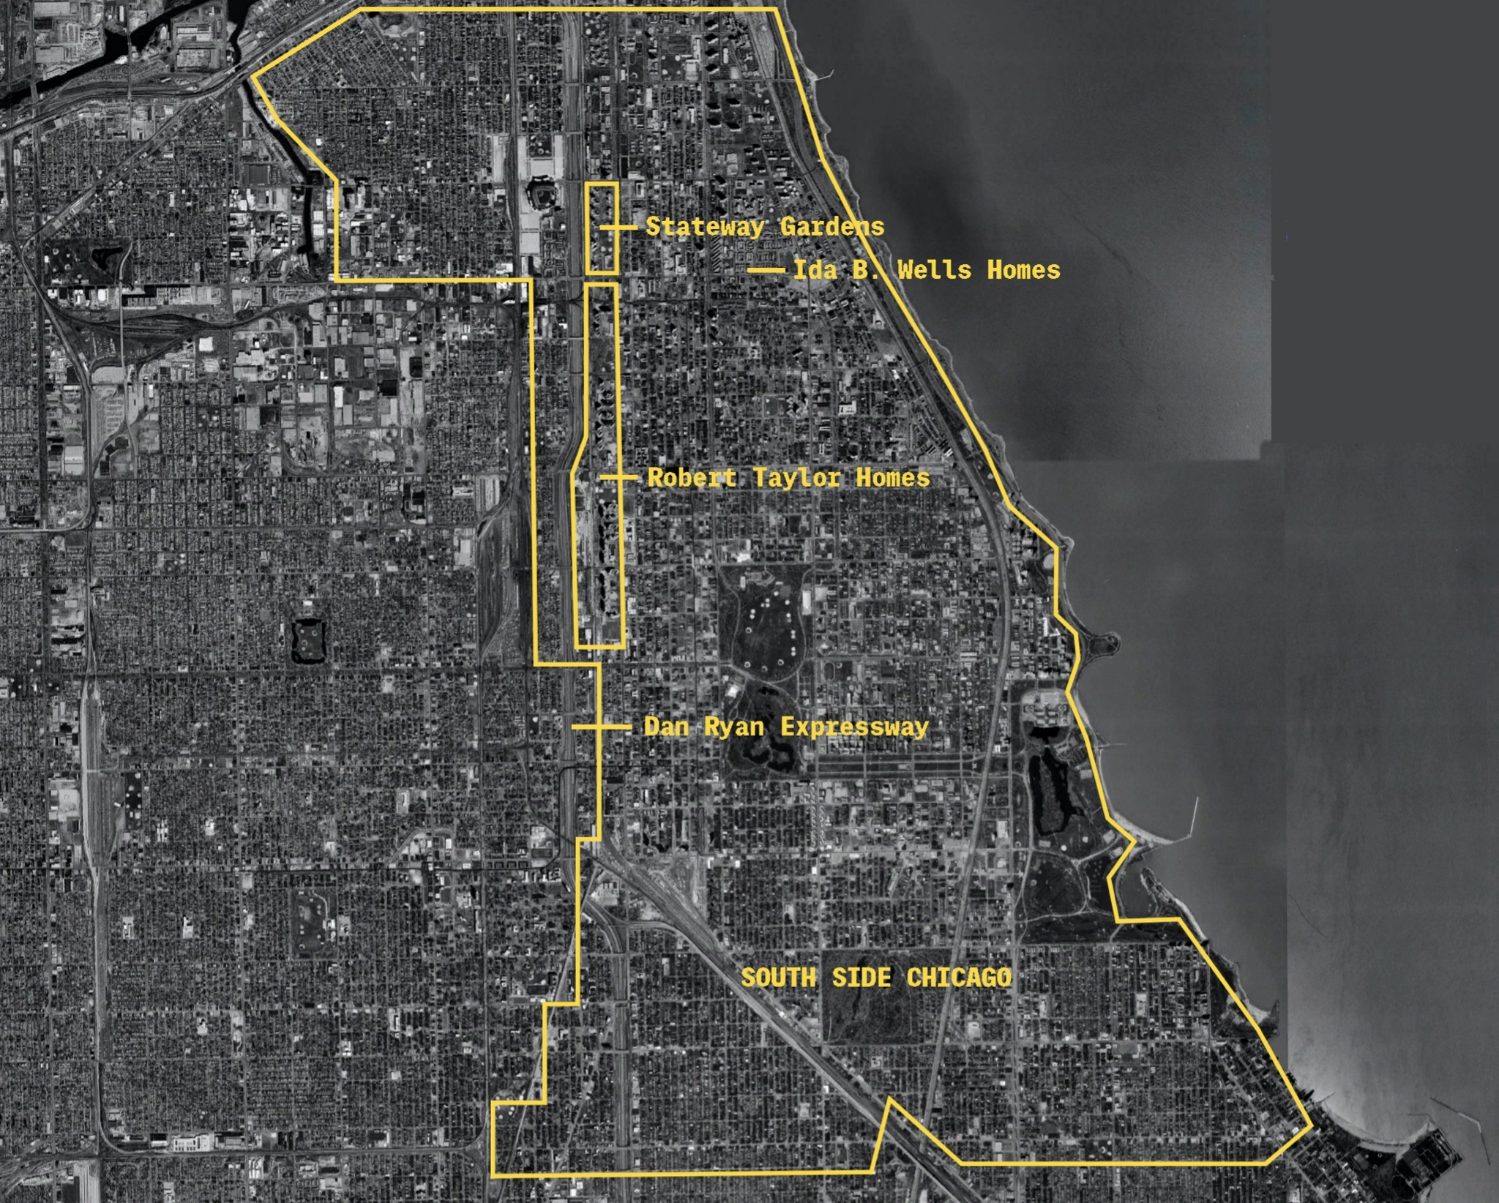

Slide 3
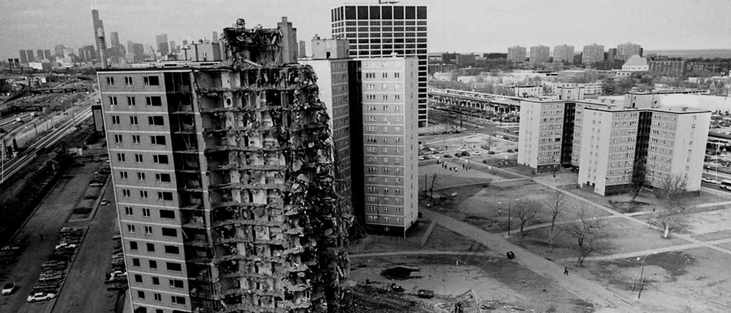

Slide 4
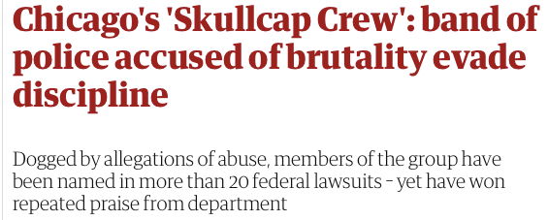

Slide 5
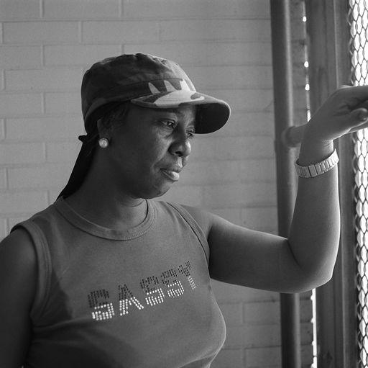

Slide 6
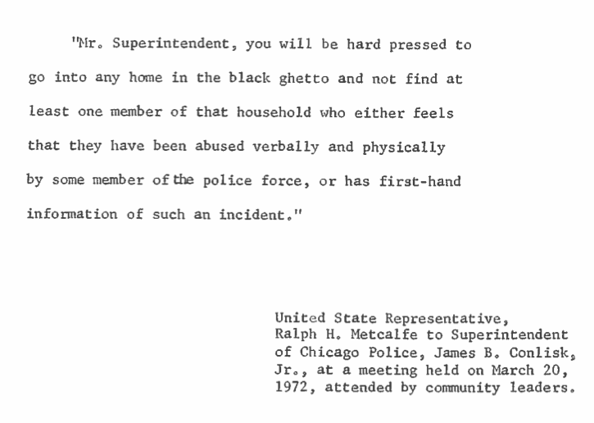
Blue Ribbon Panel, 1972

Slide 7
Kalven v. City of Chicago, 2014

Slide 8
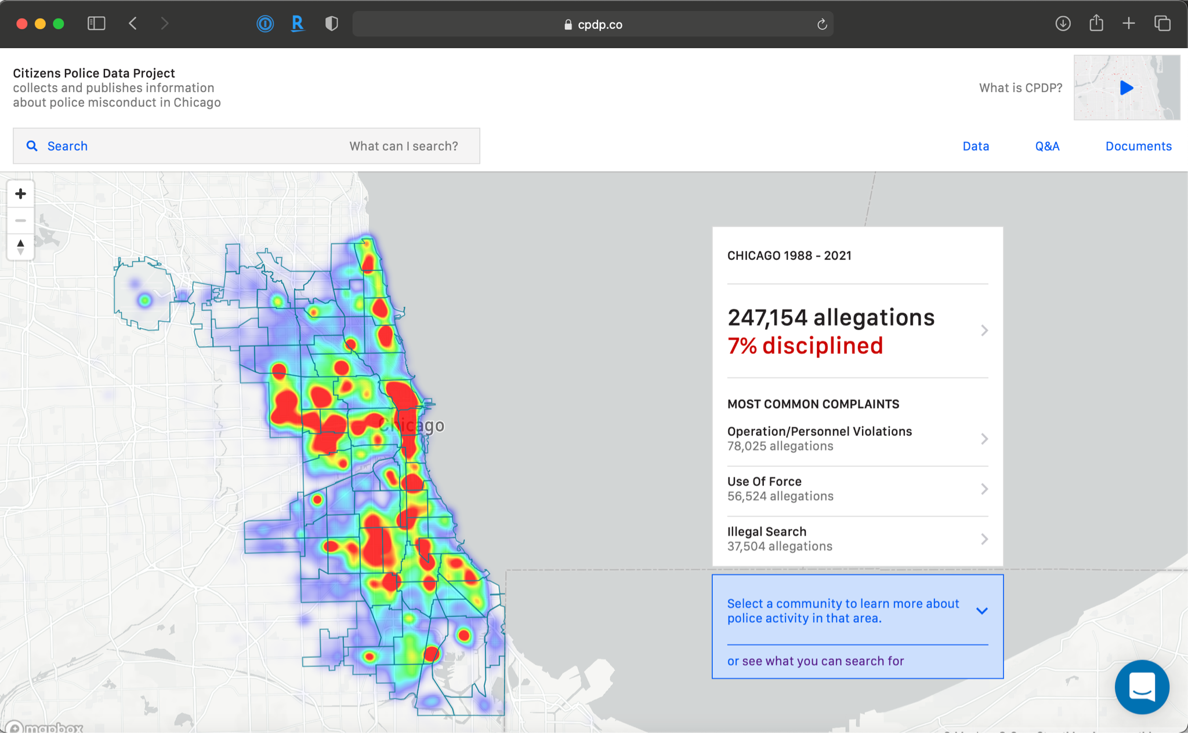
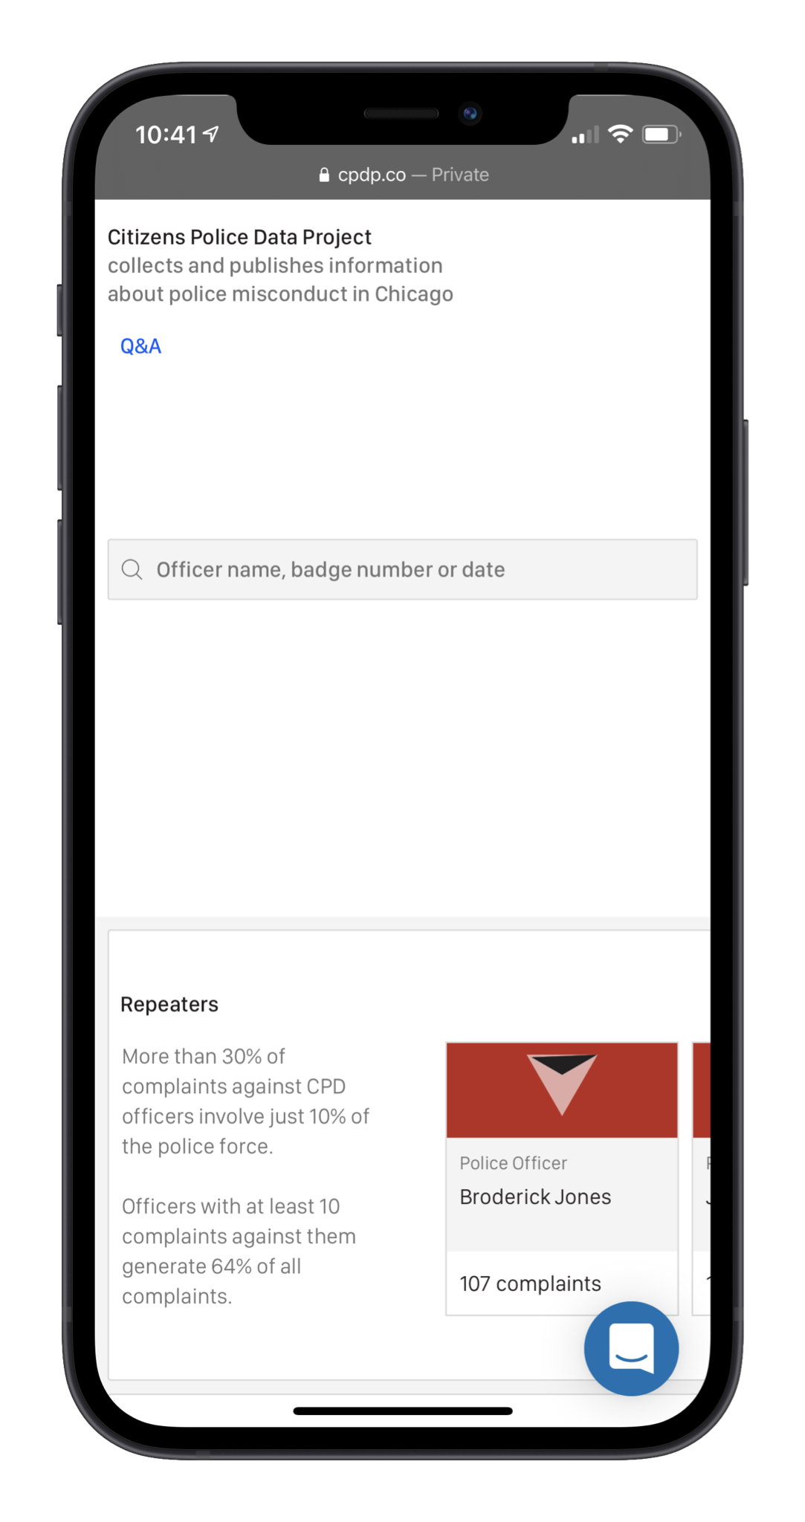
CPDP.co
Notes:
Alot of complaints, not many sustained.

Slide 9
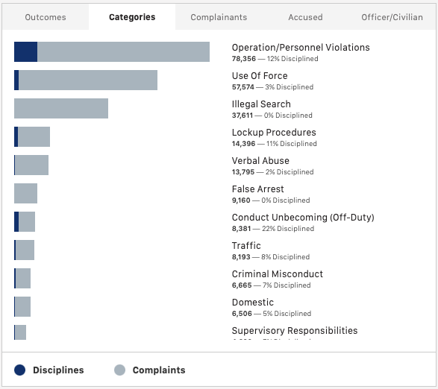
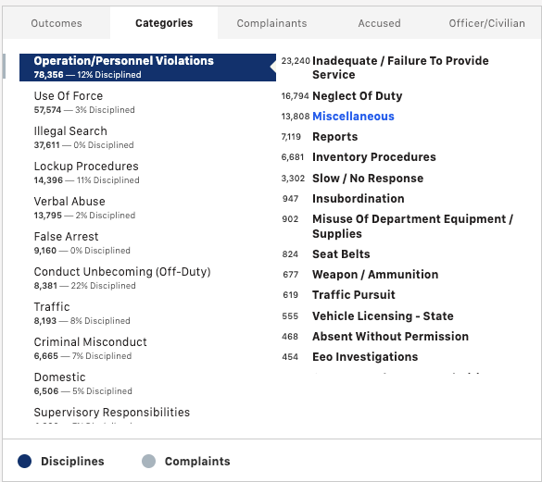
CPDP.co

Slide 10
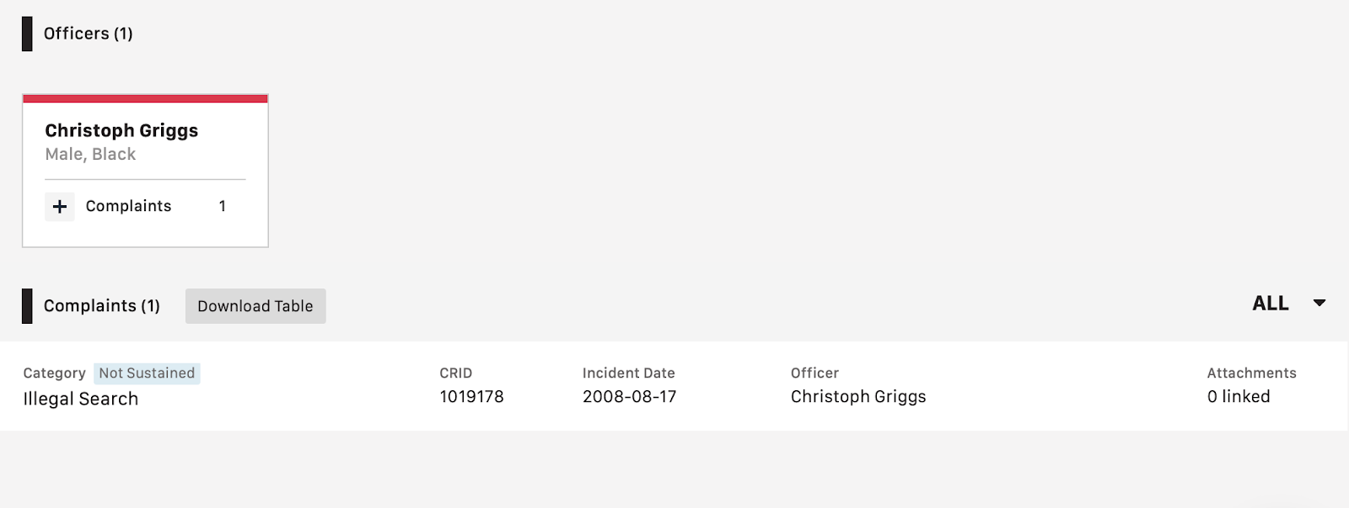
Issue with Primary Categorization
Notes:
When you search CR you’ll see illegal search

Slide 11
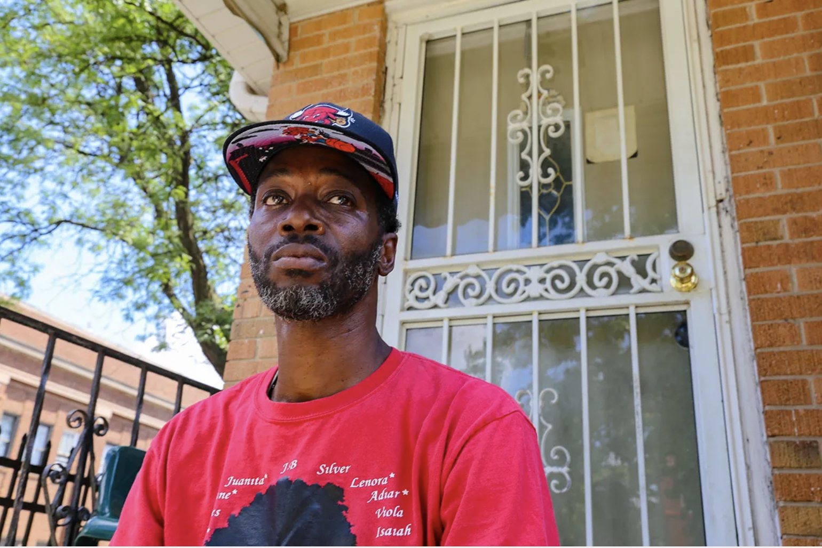
On November 18, 2015, Charles Green (Plaintiff) sent a FOIA request to the Chicago Police Department (CPD) seeking “any and all closed complaint register [CR] files that related to Chicago Police Officers.” When CPD didn’t respond, Plaintiff sued in the Circuit Court, alleging that CPD violated FOIA by failing to produce the requested documents or otherwise respond to his FOIA request.

Slide 12
Issue with Primary Categorization

Slide 13
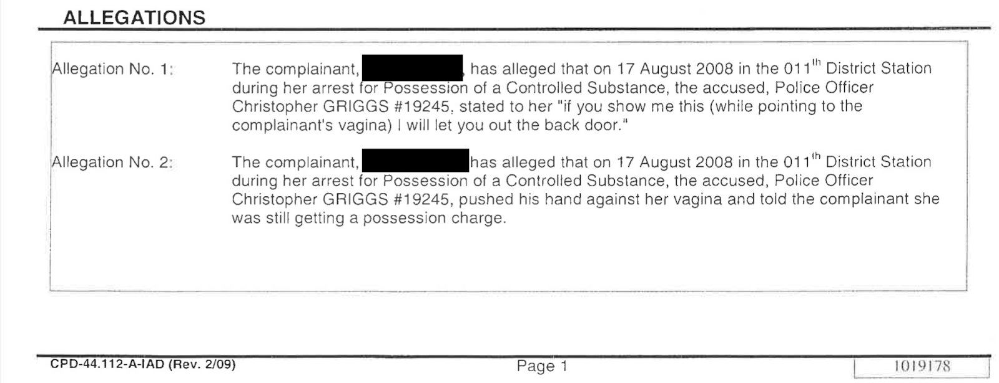
Issue with Primary Categorization

Slide 14
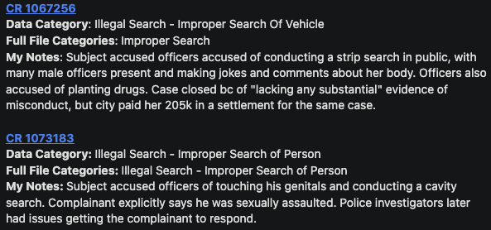
Issue with Primary Categorization

Slide 15
Beneath the Surface
Notes:
We focused on the intersection between gbv and police.

Slide 16
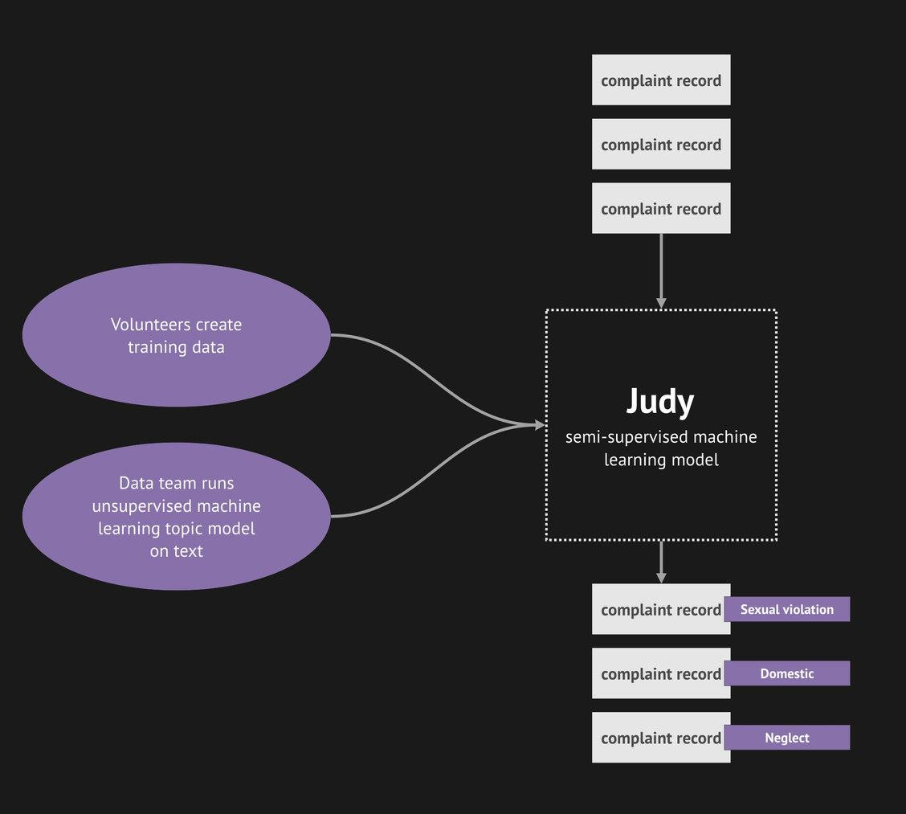
How do we incorporate feedback?
Notes:
Needle in a haystack to a haystack full of needles

Slide 17
Blue Ribbon Panel evidence of the 21st Century:
What does it look like when we remove the emphasis on individual officers and focus more on the things that complainants have in common?

Slide 18
How do we incorporate feedback?

Slide 19
Documents Pipeline Team
LUCY PARSONS LAB
Matt Chapman
Philipp Birklbauer
HRDAG
Tarak Shah
II TEAM MEMBERS
Rajiv Sinclair

Slide 20
ANNOTATION DICTIONARY
Neglect
Sexual Violation
Domestic
Home
Disabled
LGBTQIA
Reading Groups:
A Set of Expectations and Practices

Slide 21
How do we incorporate feedback?

Slide 22
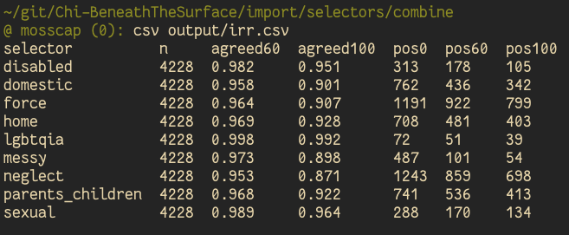
Inter-Rater Reliability: The degree of agreement among independent observers who rate, code, or assess the same phenomenon.
What kinds of strategies will improve our efforts to be a container for civilian experts on police complaints? Some ideas:
Assigning weights to distinct reviewers
Protocols for expert review of records
Using records with disagreement as examples in training materials
Every reviewer has a unique ID, their history of tagging can help determine weights

Slide 23
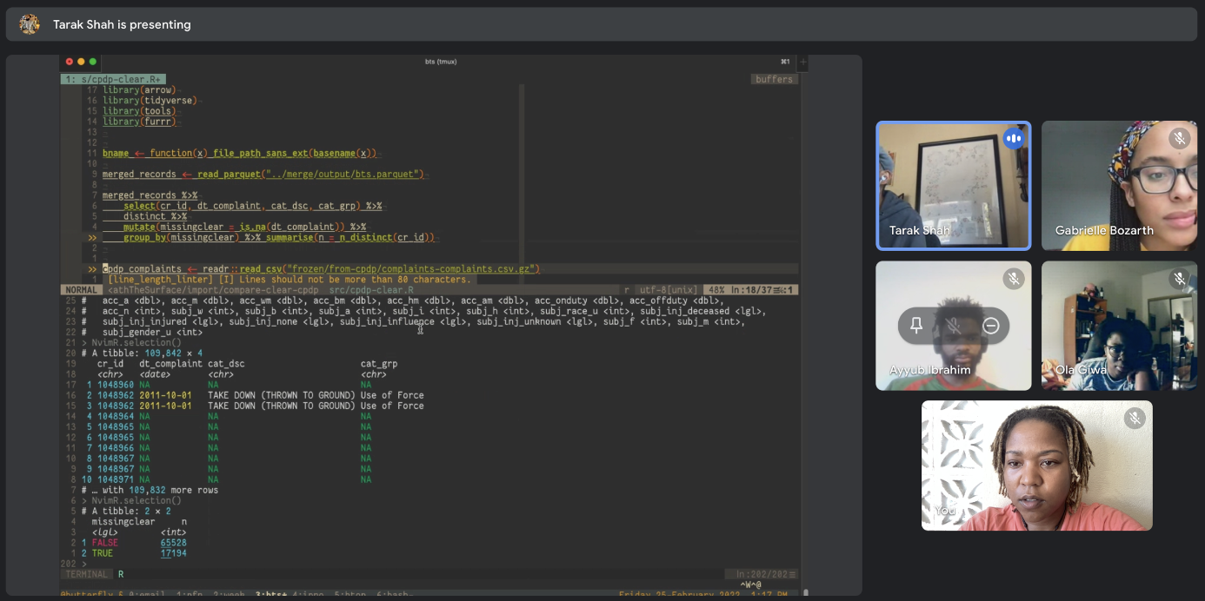
Code Review

Slide 24
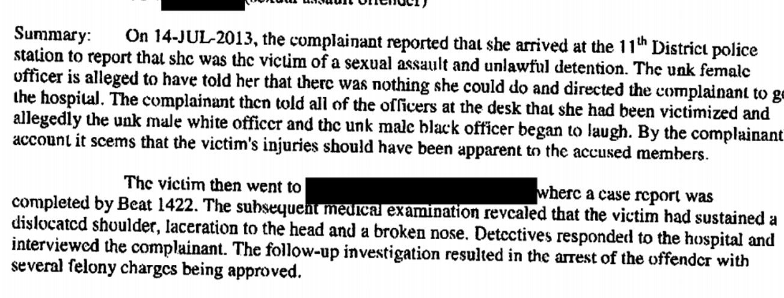
BTS Findings
Notes:
.

Slide 25
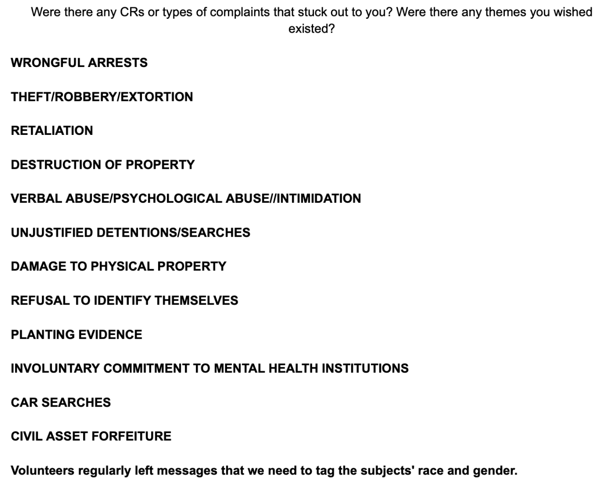
Volunteer Feedback

Slide 26
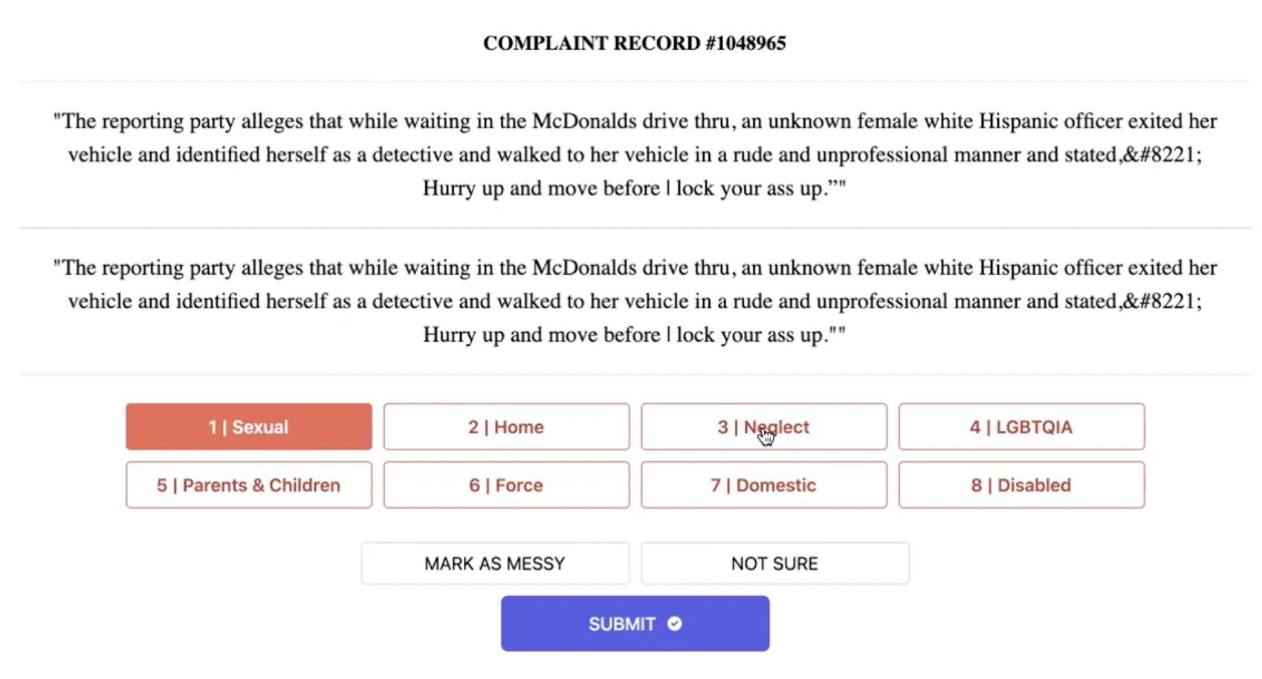
SpanTree MLK Hackathon, 2022
Notes:
Could more easily navigate

Slide 27
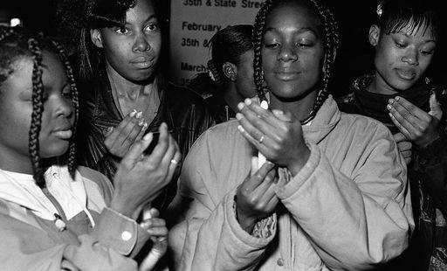
The Missing
Currently investigating missing persons cases;
54 complaint records related to an individual reporting their loved one/client missing.
Complaints show at least 1 case where an officer delivered a missing girl to be sex trafficked. He resigned keeping his pension; a separate officer went to jail for trafficking runaway girls.

Slide 28
Missing in chicago
Read our full investigation CHICAGOMISSINGPERSONS.COM
trina reynolds-tyler
trina@invisibleinstitute.com
Data Director
Sarah Conway
sarah@citybureau.org
Senior Reporter
Photo by Felton Kizer

Slide 29
Photo by Felton Kizer

Slide 30
Chicago Missing and Murdered
Our two-year investigation into how Chicago police handle missing person cases reveals
DISPROPORTIONATE IMPACT ON BLACK WOMEN AND GIRLS
POLICE MISTREATMENT OF FAMILY MEMBERS
DELAYED CASES DUE TO POOR POLICE PRACTICE
POOR DATA MAKES THE PROBLEM HARDER TO SOLVE

Slide 31
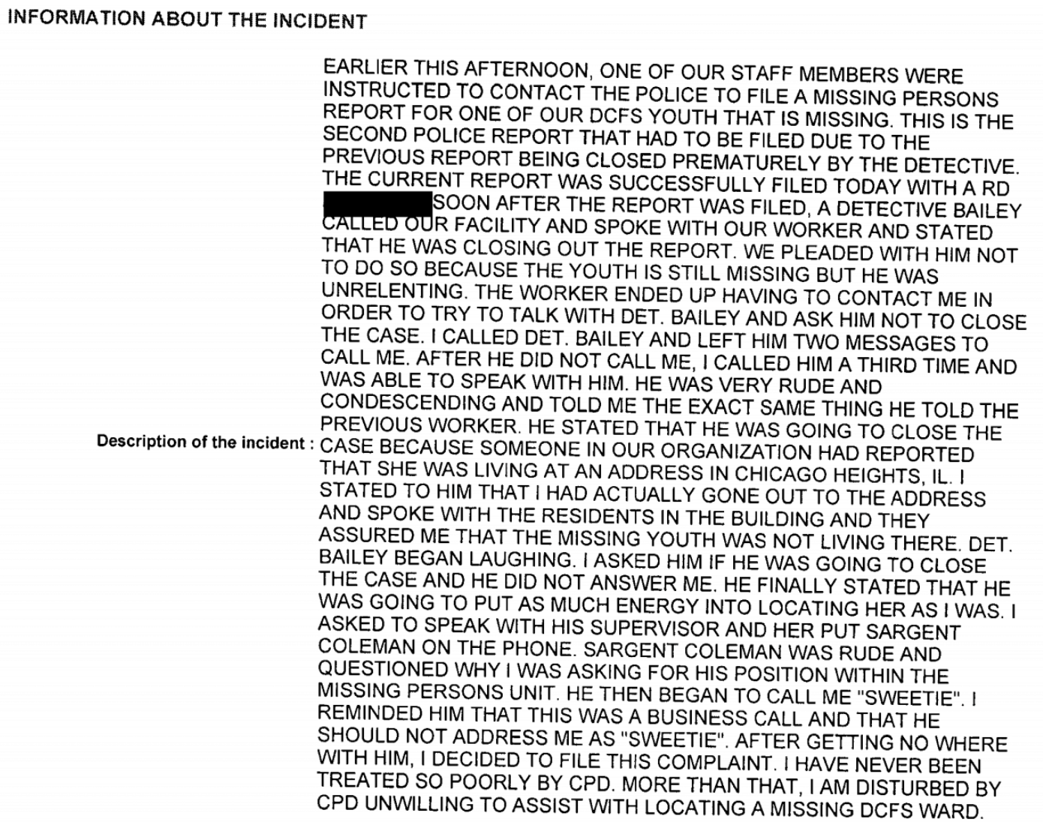
Police Misconduct complaints
Identified 54 complaints related to issues community members or DCFS Staff reported related to a missing person or child in care. See Appendix.
Evidence that, although documents show missing individual was ‘high risk,’ the cases were delayed for days.
Screenshot of a complaint filed by DCFS staff member over the premature closure of a missing person report for a youth in care

Slide 32
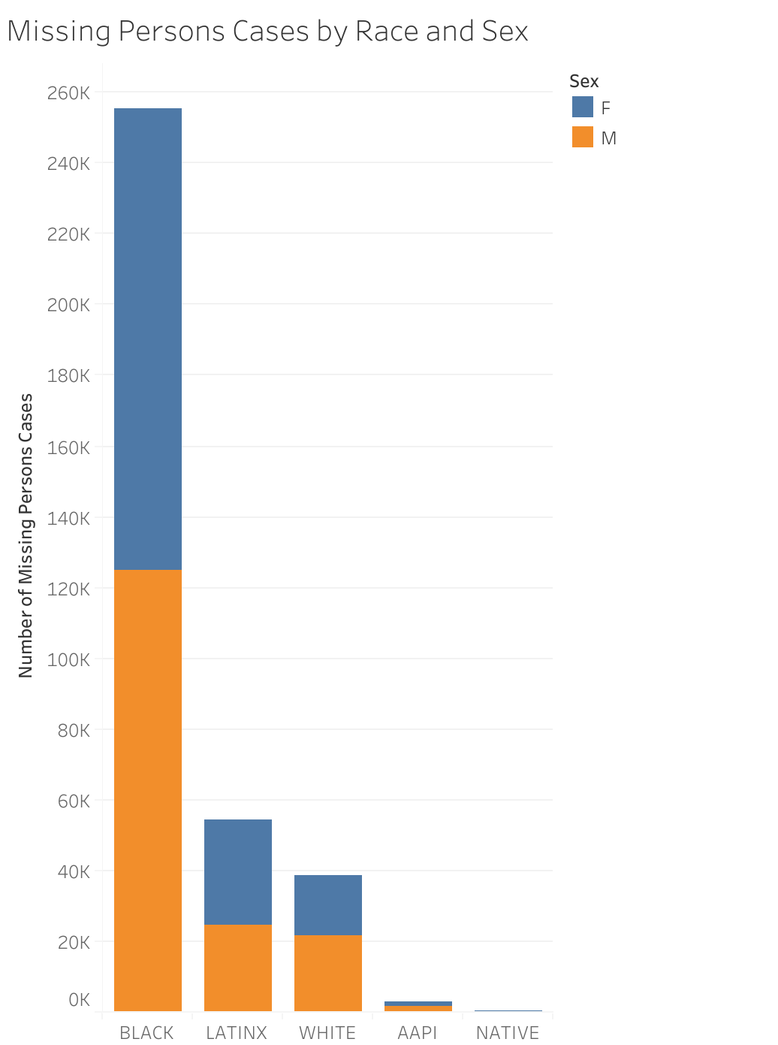
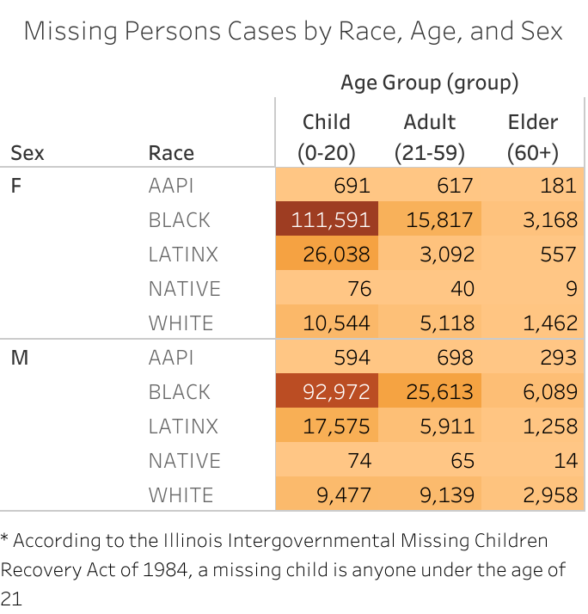
Who is Most Impacted?
Chicago Police Missing Persons Cases 2000-2021
Black people make up nearly two-thirds of all missing persons cases in Chicago over the last 20 years.
Black girls and women between the ages of 10 and 20 make up about 30% of all missing person cases in the city, according to police data, despite comprising only 2% of the city population as of 2020.
Data Visualization by Aïcha Camara

Slide 33
Some Issues Connected to Chicago Missing Person Cases
Missingness includes, but is not limited to:
Gun violence
Intimate partner abuse
Custodial abduction
Substance use abuse
Human trafficking
Suicide
Sex work and the informal economy
Inadequate housing and lack of safe space for teens – issues related to structural racism that city officials perpetually struggle to solve
“The police failed me. Even though she’s dead, she’s gone, I don’t have no answers and that’s what hurts most of all”
Tammy Pittman, mother of Shante Bohanan
Interviews with current and former police officers, national experts and researchers, along with dozens of anecdotes from impacted family members, reveal a pattern of neglect, incompetence and illegal behavior from police officers in missing person cases.
Families of the missing say police officers are dismissive of their cases, neglect their investigations and stigmatize their loved ones — including multiple cases where police declined to investigate key leads or lost evidence, leaving families to conduct their own searches.

Slide 34
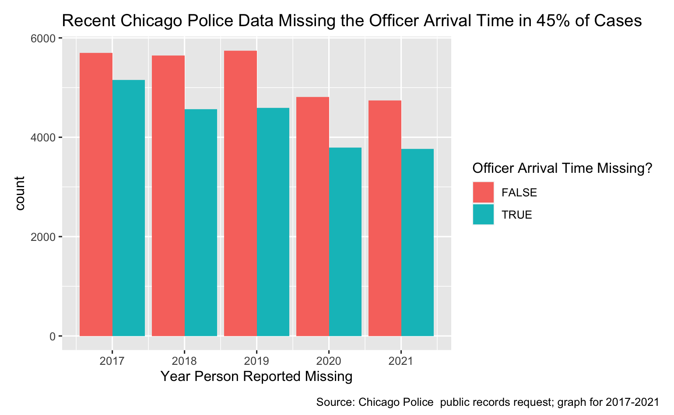
Discrepancies in Chicago Police Data
Chicago police data should provide a window into whether police do or do not respond quickly to missing person cases.
However, police records obtained by City Bureau and the Invisible Institute show enormous gaps, not only in data points that are left blank, but in the data that police do not even attempt to gather.
After a person reports their loved one as missing, how long does it take for officers to show up for a preliminary investigation? How much time do officers spend on this investigation before they alert the Missing Persons section? Do these times vary based on race, sex, age and location? Currently the Chicago Police Department’s missing persons data makes it difficult to answer these questions definitively.
We found 11 cases which were marked as closed non-criminal even though they were associated with a homicide – including two cases where chicago police noted the missing had returned home safely, however, the individuals were murdered.
Data Analysis and Visualization by Trina Reynolds-Tyler

Slide 35
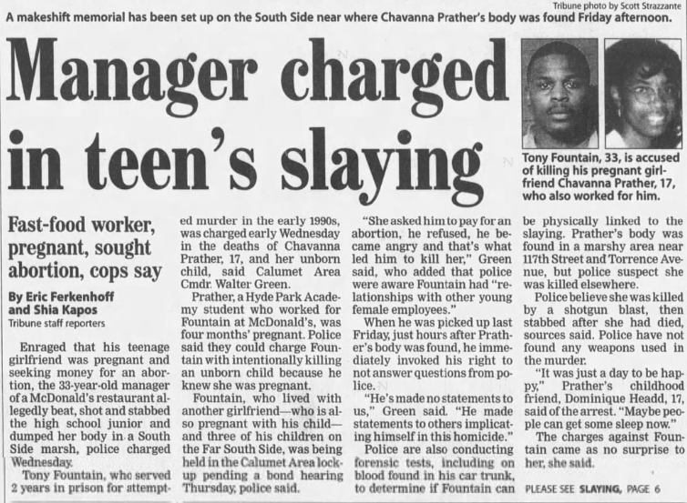
Premature closure
In 2002, when Chavanna Prather, a 17-year-old Chicago Public School student at Hyde Park Academy, didn’t come home from work, her mother reported her missing. A tall and athletic Black girl with a bob, she was three months pregnant and last seen leaving her shift at a South Side McDonalds with an older male manager.
Two days later, the police officer assigned to her case closed it, claiming that he spoke with her mom and she had been located. The officer wrote in the closing notes: “Victim/Offender: No.”
Two hours after that, she was found strangled, stabbed and shot, still wearing her work uniform, face down in a South Side swamp. Moss had begun to grow on her body; a police document stated she had likely been there for days.
Police then began a death investigation, and later arrested the store manager for her murder.
But her missing persons case was never tied to the homicide—it joined that 99.8% of missing persons cases in the last 20 years that Chicago Police classified as closed and not related to any crime.

Slide 36
data
Chicago Police Missing Persons Data
Reported Crime and OEMC Data
Cook County Sheriff's Missing Persons Project
Medical Examiner Death Data

Slide 37
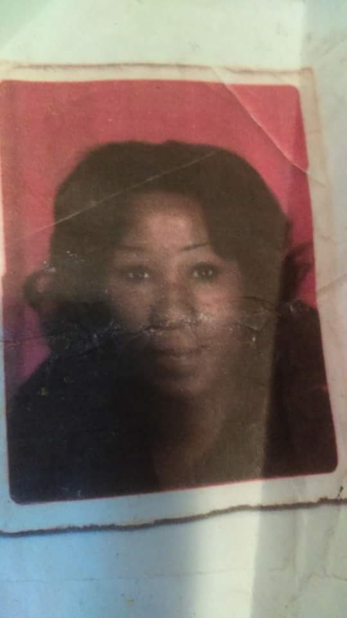
Discrepancies in the Data
In the case of 61-year-old Linzene Franklin, who was reported missing in 2011, a detective claimed in a 2014 Chicago police report that she had returned home without incident.
In reality, Franklin died of a heart attack at a north side bus stop in 2013 and was later buried as an unidentified person. Her body remained in a south side Roman Catholic cemetery for nine years before Cook County police connected the two cases and alerted Franklin’s family. Franklin’s daughter told Cook County police she hadn’t seen her mother since 2011.
The Cook County Sheriff’s Office’s Missing Persons Project closed Linzene Franklin’s case in 2022 after successfully matching Franklin’s DNA with a family member’s. Linzene’s daughter had provided DNA to the Sheriff's during Missing Persons Day.
Commander Jason Moran, who leads the team, confirmed in an interview with City Bureau and the Invisible Institute that the CPD had prematurely closed the case.
Photo of Linzene Franklin

Slide 38
ELEVEN Additional Homicides
Between 2000 and 2021, the Chicago Police Department claims that just over 343,000 (99.8%) of missing person cases were “closed non-criminal,” meaning the person was “likely found” and the case was “not criminal in nature.”
In fact, police data from this time period identifies less than 300 missing person cases that were reclassified as a crime and only 10 of these as homicides.
These 11 cases were closed non-criminal, but all resulted in a murder. Homicide investigations were opened for their cases.

Slide 39
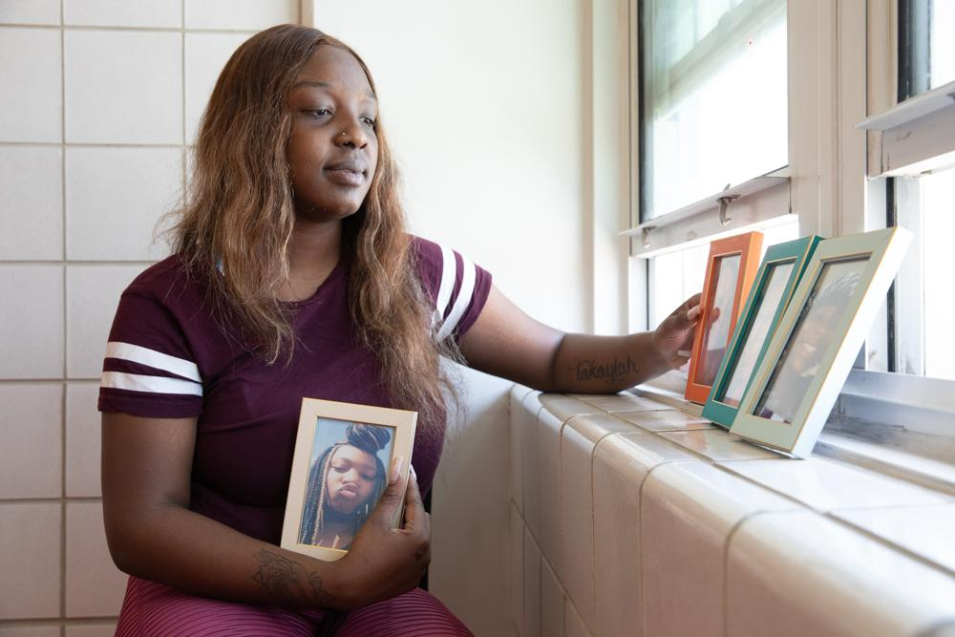
Takaylah Tribitt
Neighborhood: Noble Square
Last seen: 2019
Age last seen: 14
Located: Yes. Died by homicide.
A Night Ministry temporary youth shelter employee reported Tribitt missing to the Chicago Police Department on Sept. 2, 2019. She had run away 10 times that year, according to a police case file.
Less than 24 hours later, she met up with an older man who started beating her, a case file recounts.
“[Tribitt] was just trying to survive, to have food to eat,” says her friend Jada Nile. Deonlashawn Simmons, who was in his early 30s, had been corresponding with Tribitt on Facebook Messenger, according to a police report.
Despite being a 14-year-old girl coping with mental illness who could have been classified as a high-risk missing person, which would require immediate action according to Chicago Police policy, a detective was not assigned to her case until Sept. 7, six days after she was first reported missing. A detective finally interviewed the person who reported her missing on Sept. 11, according to her case file.
Tamia Scott holds a photograph of her best friend Takaylah Tribitt
Photo by Natasha Moustache

Slide 40
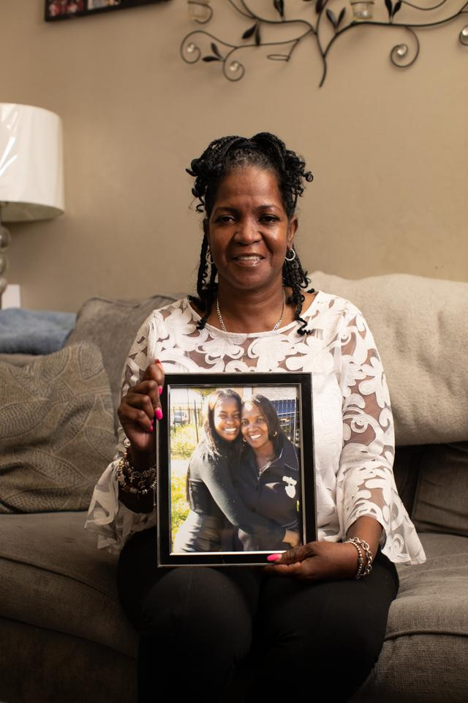
Shante bohanan
Neighborhood: Marquette Park
Last seen: 2016
Age last seen: 20
Located: Yes. Died by undetermined
cause.
A few weeks before she went missing, Shante Bohanan had started dating a young man. While they were walking together, her boyfriend was shot and killed.
Bohanan went to pay her condolences and later called her family to say that she had a “gun held to her head” and was not allowed to leave the boyfriend’s family’s house, an incident documented in police reports. Her mother went to the police station to ask officers to search the house, but officers suggested that Bohanan had run away, she says. They urged her to wait another 24 hours before reporting her daughter missing, against state law and police policy. Pittman remembers she brought Bohanan’s dad to the station with her the next day to insist that the officers accept the missing person report, which they did.
It wasn’t until the night after Pittman says she first contacted police that officers finally searched the home where she suspected Bohanan was being held, and found nothing. Two days later, her daughter’s body was found naked in a garbage bag in a garage on 92nd Street in Burnside. The cause of death is “undetermined,” according to the medical examiner’s office.
Tammy Pittman, Shante Bohanan’s mother

Slide 41
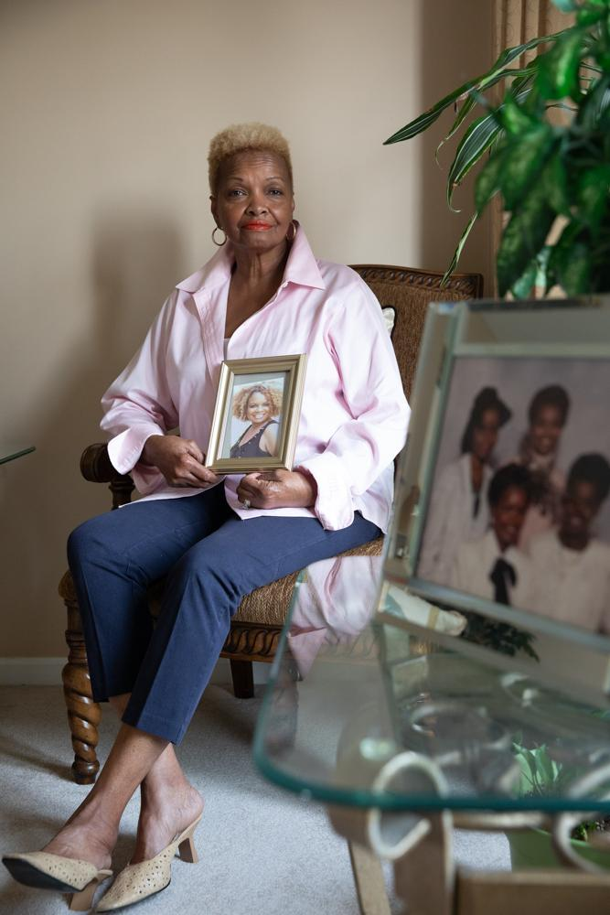
Sonya Rouse
Neighborhood: Greater Grand Crossing
Last seen: 2016
Age last seen: 50
Located: No. Still missing.
Sonya Rouse went missing in March 2016
at the age of 50. Rouse started seeing a man and moved in with him at a house in Greater Grand Crossing. He physically abused Rouse, her mother Shirley Enoch-Hill says.
“It hurts you to see your child being abused, beaten like that. It seems like they’re listening, but when they go back, it’s like the abuser has the upper hand,” says Enoch-Hill.
According to police documents, the boyfriend was in a work release program through the Illinois Department of Corrections. An IDOC official said they could accommodate an interview by bringing the boyfriend back into custody, but Detective Brian Yaverski stated that he would wait until the boyfriend was fully released.
Medical examiner data shows that he died of fentanyl overdose in December 2018, and there’s no indication in police records that he was ever interviewed in relation to Rouse’s case.
Detective Yaverski Complaint Record
Shirley Enoch-Hill, Sonya Rouse’s mother

Slide 42
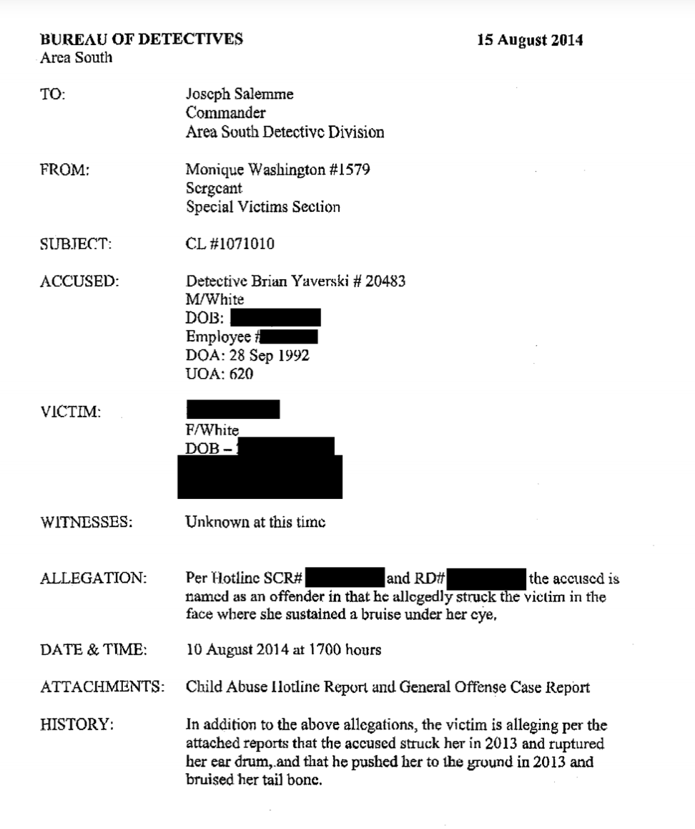

Slide 43
public safety Committee
Delay and denial of missing persons cases
Police negligence in investigations, adherence to case closure procedures and reporting requirements
Premature closure of missing persons cases and their connection to crime
Investment in survivor and community identified and led-solutions

Slide 44
Thank you
Read our full investigation CHICAGOMISSINGPERSONS.COM
trina reynolds-tyler
trina@invisibleinstitute.com
Data Director
Sarah Conway
sarah@citybureau.org
Senior Reporter
Photo by Felton Kizer

